Slide 1
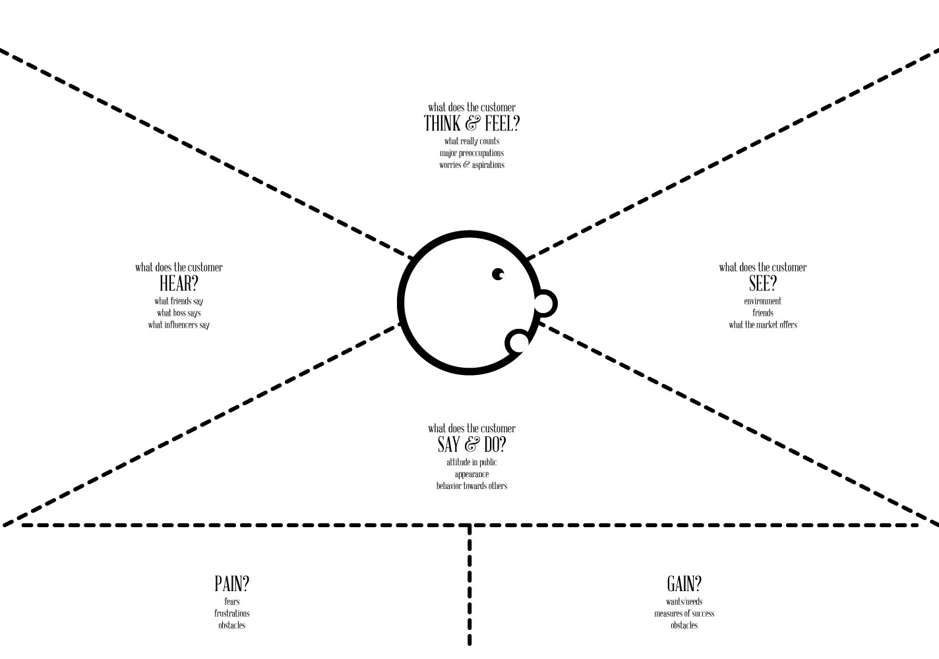
I need to have custom options to meet my needs
I want my experience to be easy , friendly and fast.
I want choice
I want to know where my order is and when it will arrive
I want to know what support is available
I did not take this job to worry about tech tools.
My PC never works as promised.
I need my tech to be mobile as my job is on the road.
The new system is coming
There will be options
You will be able to see and control your order
You will need to login on your own and track your order
It will be user-friendly
Budget overflow
Un-kept promises from vendors
Better commercial experiences (e.g. Amazon.com)
Antiquated Government systems.
Not enough flexibility in my tools.
Resistance towards new tools
Sarcasm based on past experience
Excitement about new tool and options
Tell my friends (good) or warn them (bad)
Fast and friendly UI/UX
Large selection of options
User input driven and supported
Easy to learn
Dependable, stable experience
Slow or unfriendly
Not enough selection
Lack of support and/or input
Forced to learn new tool
Instability of experience

